Slide 1

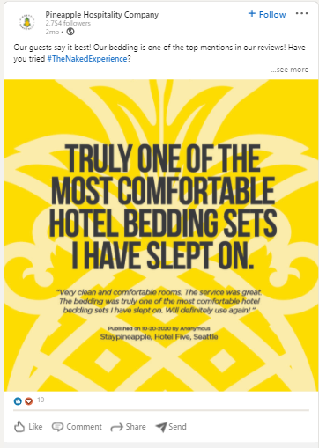
Pineapple Hospitality:
Marketing Planning & Social Media Assessment
Client Need
Pineapple Hospitality is an eco-friendly hotel amenities supplier. They came to Affirma looking for strategic marketing planning and support as their existing efforts were siloed across different tactics. In addition, they were interested in a social media assessment along with competitor analysis.
What We Did
Affirma completed a comprehensive social media audit with competitor analysis to help prioritize next steps in order to optimize performance. In addition, we reviewed existing marketing documents, such as documented processes, style guide, buyer personas and more to uncover any gaps. Affirma identified several key areas to focus on in order to help create a more cohesive marketing strategy. This included developing a keyword matrix and content map that can be used across all tactics. Finally, Affirma provided a variety of templates to help with future planning, such as a content matrix, email best practice checklist, marketing plan spreadsheet and more.
The social media assessment was very specific and the templates that were provided to help us with personas, planning and email will be very useful.
Sharon Andrade, VP Sales
Pineapple Hospitality

